Slide 1

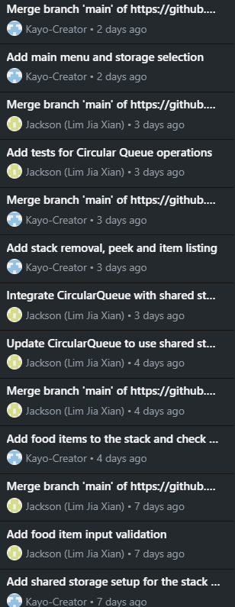
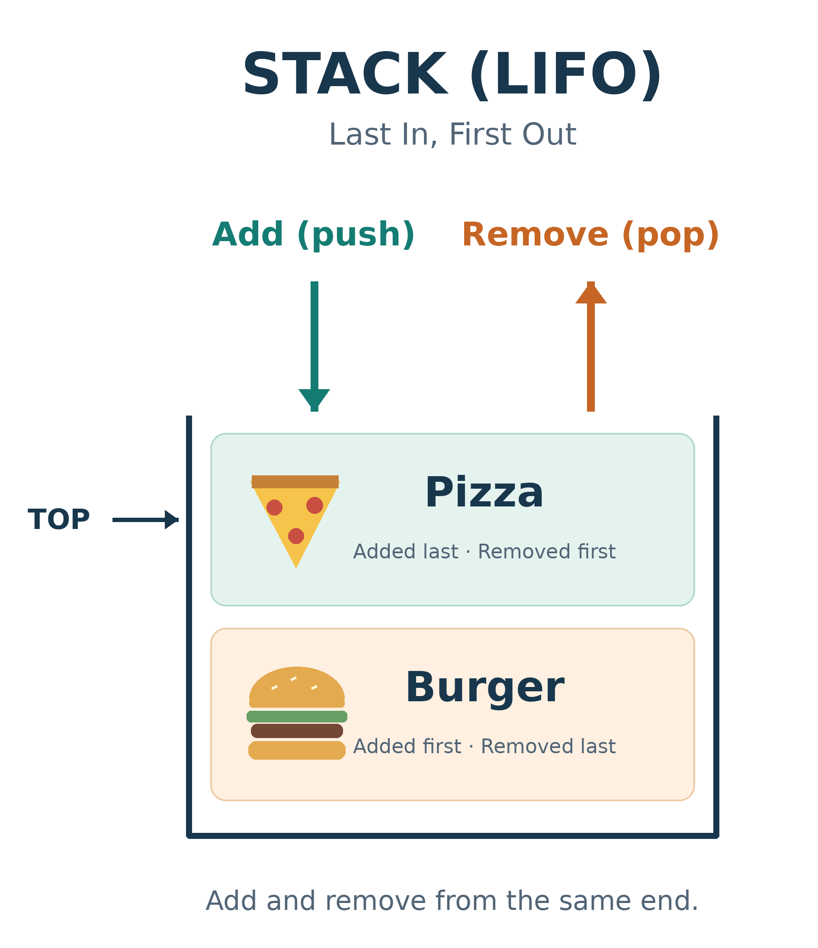
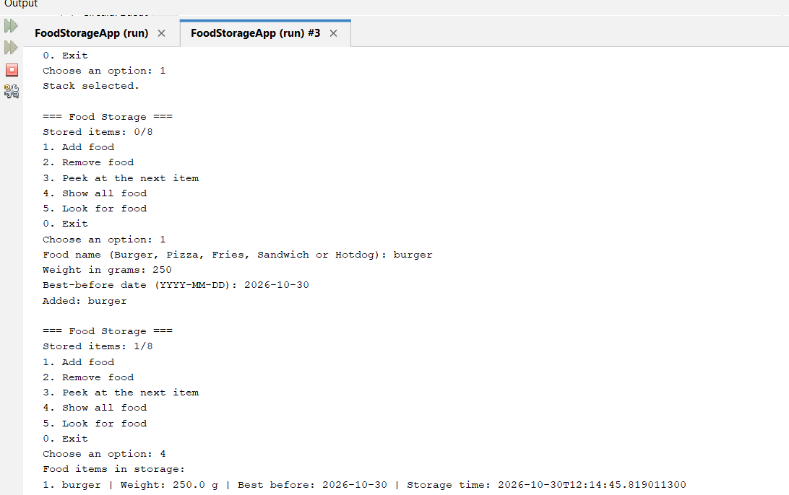
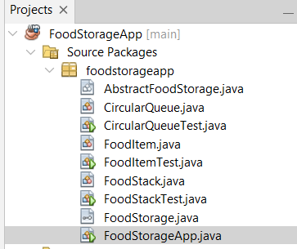
CA1 – ALGORITHMS & DATA STRUCTURES
FOOD STORAGE APPLICATION IN JAVA
Student: Lim Jia Xian(2024615), Kayo Nunes Rocha(2024556)
Lecturer: Taufique Ahmed
Useful links: GitHub repository https://github.com/Kayo-Creator/CA-1-Algorithms.git
    Video link: https://drive.google.com/file/d/1PNkcGubjQ26uaLFwmuKiB2SpMh2-ekoo/view?usp=sharing
Project Overview
This Java application stores Burger, Pizza, Fries, Sandwich and Hotdog. Each structure holds up to eight items. The stack supports adding and removing from the same side, while the queue supports opposite sides.
front =0
CIRCULAR QUEUE - Jackson
rear =2
Count=3
Burger
Pizza
Fries
FoodItem and Stack - Kayo
FoodItem stores food names, weights, best-before dates and entry times. It checks permitted foods, positive finite weights and dates from today to 14 days ahead.
FoodStack uses LIFO: the last item added is removed first. matching access from one side (OpenDSA, n.d.-b).
Both structures follow FoodStorage, allowing the same menu to use either one. My menu supports storage selection and Exit, and connects the operations, including lim Jia XIan’s Display and Search methods.
Time Complexity
Add, Remove and Peek take O(1). Display and Search take O(n) because they process the stored items.
1
2
3
4
5
6
7
8
CircularQueue uses FIFO: the first item added is removed first. This matches adding food at one side and removing it from the opposite side (OpenDSA, n.d.-a).
An eight-position array uses front, rear and count. The modulo operator (%) wraps indexes to reuse empty positions.
My contribution covers the queue, shared Display and Search methods, and food validation.
My contribution includes:
Add and Remove: Add food at the back. Remove food at the beginning.
Display: view the info on saved food; name, weight, best-before date and storage time.
Search: Search for foods by name – no case sensitivity.
Input Validation: ONLY accept these five food names, positive finite weights, and best-before date from today to 14 days from today.
The queue also checks its capacity before adding an item. Invalid items are rejected to keep the stored data accurate.
Object-Oriented System Design
Advantages and Disadvantages
Advantage: Both have regular behavior and fixed size. Arranging items in a Circular Queue reuses array locations and maintains first in first out order. Use a Stack for easy, last in, first out access. Validation helps avoid putting invalid items into storage.
Disadvantages: Both are limited to eight items. The Circular Queue removes the first item entered, but can't remove from the middle. The Stack removes the most recent entry, so may still have old food. Searching is linear.
FoodItem keeps its fields private. FoodStorage is an interface with shared operations. AbstractFoodStorage holds the eight-item array and count checks. FoodStack and CircularQueue inherit from it. FoodStorageApp connects the menu to either structure.
Time Complexity
For both structures, Add, Remove, and Peek take O(1) time because they access the needed position directly.
Display and Search are O(n) because they could potentially have to look at everything stored (OpenDSA, n.d.-a; OpenDSA, n.d.-b).
Application testing.
REFERENCES
Oracle.com. (2025). Java.Time (java SE 17 & JDK 17). [online] Available at: https://docs.oracle.com/en/java/javase/17/docs/api/java.base/java/time/package-summary.html [Accessed 30 Oct. 2026].
OpenDSA (n.d.-a) Queues. Available at: https://opendsa-server.cs.vt.edu/ODSA/Books/CS2/html/Queue.html (Accessed: 27 October 2026).
OpenDSA (n.d.-b) Stacks. Available at:https://opendsa.cs.vt.edu/OpenDSA/Books/Catalog/html/StackArray.html (Accessed: 27 October 2026).

